Slide 1
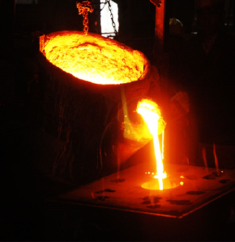

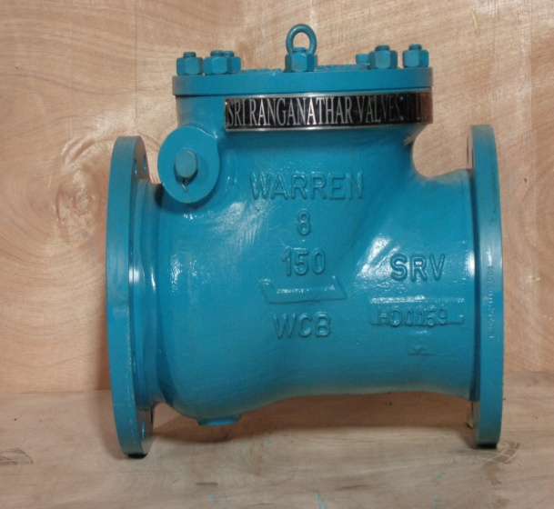
Sri Ranganathar Valves Private Limited
“Quality Flow in Every Valve”

Slide 2
SRV Established in the year 1995
One of the group companies of SRI Unit 1 & SRI Unit 2
Having In-House CNC Pattern Manufacturing, Sand casting foundry, CNC Machining, Assembly, Pressure testing, NDE like RT, UT, MPT, LPT and Special Testing like Fire safe testing, Cryogenic testing, Vacuum pressure testing, Fugitive emission testing, High-Pressure Gas Testing, Flow Testing and Cycle Testing.
QMS to ISO 9001–2015
EMS to ISO 14001-2015 & ISO 45001-2007
API Monogram for API-6D.
API Monogram for API-20A.
API Monogram for API-603.
API Monogram for API-600.
Norsok M650- ASTM A995 Gr.4A/CD3MN, Gr. 5A/CE3MN & Gr. 6A/CD3MWCuN
PED - AD2000
IBR Certified
Marine Certification by BV/DNV/ABS/LLOYDS

Slide 3
FOUNDRY CAPACITY | CRUSIBLE | CRUSIBLE | CRUSIBLE | CRUSIBLE | CRUSIBLE | CRUSIBLE |  |  | C1 | C2 | C3 | C4 | C5 | C6
RATED CAPACITY IN Kgs PER MELT | 75 | 150 | 350 | 500 | 2000 | 3000 |  | MOLD REQUIRED PER HOUR | 0.0 | 4.0 | 1.4 | 2.7 | 1.7 | 1.1
MAXIMUM CAPACITY Kgs PER MELT | 90 | 190 | 380 | 650 | 2500 | 3750 |  | MOLD REQUIRED PER DAY | 0.2 | 95.0 | 32.6 | 65.0 | 40.0 | 26.3
MAXIMUM No.s OF HEAT PER DAY | 0.08 | 15 | 6 | 10 | 6 | 5 |  | HEAT TREATMENT | HTF1 | HTF2 | HTF3 | HTF4 | HTF5 | HTF6
MAXIMUM WEIGHT MELTED PER DAY | 7.2 | 2850 | 2280 | 6500 | 15000 | 18750 |  | CAPACITY IN Kgs | 1250 | 2500 | 2500 | 4500 | 6000 | 6000
MAXIMUM WEIGHT MELTED PER MONTH | 180 | 71250 | 57000 | 162500 | 375000 | 468750 |  | HT CYCLE PER DAY | 2 | 2 | 2 | 2 | 2 | 2
 | 1134,680 Kgs |  |  |  |  |  |  | HT CAPACITY / MONTH Kgs | 62500 | 125000 | 125000 | 225000 | 300000 | 300000
SINGLE PIECE CASTING WEIGHT MAX | 4000 Kgs
 |  |  |  |  |  |  |  | HT CAPACITY / MONTH-TONS | 1138
MONTHLY TONNAGE OF GOOD CASTINGS | 624 Tons |  |  |  |  |  |  | BALANCE AVAILABLE Tons
RESERVED FOR WARREN | 60 |  |  |  |  |  |  | 564
RESERVED FOR DeZURIK | 50 |  |  |  |  |  |  | 514
RESERVED FOR CAMERON | 40 |  |  |  |  |  |  | 474
RESERVED FOR LEE VALVES | 20 |  |  |  |  |  |  | 454
RESERVED FOR EMERSON ISV | 30 |  |  |  |  |  |  | 424
RESERVED FOR EMERSON PRM | 10 |  |  |  |  |  |  | 414
RESERVED FOR EMERSON FCV | 0 |  |  |  |  |  |  | 414
RESERVED FOR FORUM | 5 |  |  |  |  |  |  | 409
RESERVED FOR OTHER SRV CUSTOMERS | 15 |  |  |  |  |  |  | 394
STILL AVAILABLE |  |  |  |  |  |  |  | 394

Slide 4
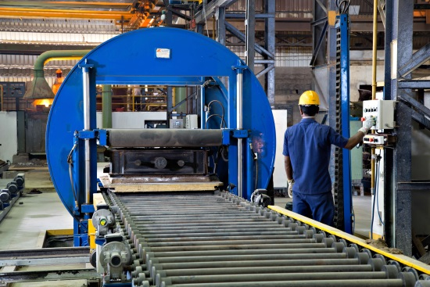
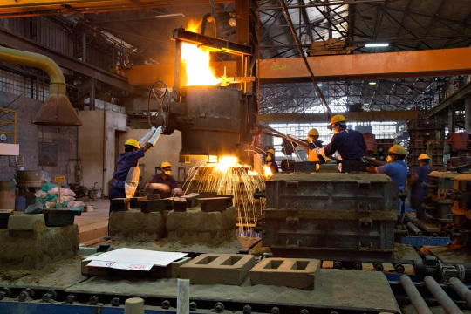
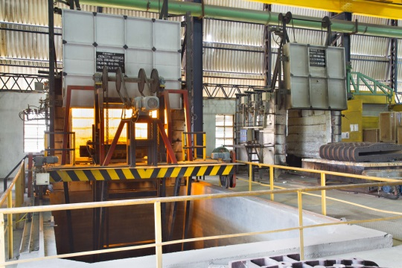
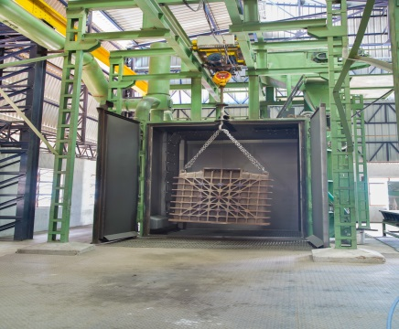

Slide 5
List of Material Grades
A216 WCB, WCC
A217 WC6, WC9,C5, C12, C12A & CA15
A351 CF8, CF8M, CG8M, CF3, CF3M, CG3M,CF8C, CK20, HK40, CN3MN, CN7M & CK3MCuN
A352 LCB, LCC, CA6NM
A487 4C & 4D
A494 CZ100, M35-1, M35-2, N12MV, VY-40, CW12MW, CW6MC, CX2MW, CU5MCuC
A747 CB7Cu,
A995 1B, 4A, 5A & 6A

Slide 6
SRV VALVES - SIZES & RATINGS
DESIGN | TYPE | 1/2'' | 3/4'' | 1'' | 1.5'' | 2'' | 2.5'' | 3'' | 4'' | 5'' | 6'' | 8'' | 10'' | 12'' | 14'' | 16'' | 18'' | 20'' | 24'' | 30'' | 36'' | 42'' | 48'' | 54'' | 60'' | 72''
API-600 | WGV |  |  | Y | Y | Y | Y | Y | Y | Y | Y | Y | Y | Y | Y | Y | Y | Y | Y | Y | Y | Y
API-603 | WGV |  |  | Y | Y | Y | Y | Y | Y | Y | Y | Y | Y | Y | Y | Y | Y | Y | Y | Y | Y | Y
API-623 | GLV | Y | Y | Y | Y | Y | Y | Y | Y | Y | Y | Y | Y | Y | Y | Y | Y | Y | Y
API-6D | SCV | Y | Y | Y | Y | Y | Y | Y | Y | Y | Y | Y | Y | Y | Y | Y | Y | Y | Y | Y | Y | Y
API-594 | DDCV | Y | Y | Y | Y | Y | Y | Y | Y | Y | Y | Y | Y | Y | Y | Y | Y | Y | Y | Y | Y | Y | Y | Y | Y | Y
API-594 | SDCV | Y | Y | Y | Y | Y | Y | Y | Y | Y | Y | Y | Y | Y | Y | Y | Y | Y | Y | Y | Y | Y | Y | Y | Y | Y
API-594 | TDCV | Y | Y | Y | Y | Y | Y | Y | Y | Y | Y | Y | Y | Y | Y | Y | Y | Y | Y | Y | Y | Y | Y | Y | Y | Y
API-608 | FBV | Y | Y | Y | Y | Y | Y | Y | Y | Y | Y | Y | Y | Y | Y | Y | Y | Y | Y
API-608 | TMBV | Y | Y | Y | Y | Y | Y | Y | Y | Y | Y | Y | Y | Y | Y | Y | Y | Y | Y
API-609 | DOBFV | Y | Y | Y | Y | Y | Y | Y | Y | Y | Y | Y | Y | Y | Y | Y | Y | Y | Y | Y | Y | Y | Y | Y | Y | Y
API-609 | TOBFV | Y | Y | Y | Y | Y | Y | Y | Y | Y | Y | Y | Y | Y | Y | Y | Y | Y | Y | Y | Y | Y | Y | Y | Y | Y
MSS SP 81 | KGV | Y | Y | Y | Y | Y | Y | Y | Y | Y | Y | Y | Y | Y | Y | Y | Y | Y | Y | Y | Y | Y | Y | Y | Y
ASME B16.34 | STRAINER | Y | Y | Y | Y | Y | Y | Y | Y | Y | Y | Y | Y | Y | Y | Y | Y | Y | Y
ASME B16.34 | ARV | Y | Y | Y | Y | Y | Y | Y | Y | Y | Y | Y | Y | Y
ASME B16.35 | VRV | Y | Y | Y | Y | Y | Y | Y | Y
PRESSURE RATINGS # |  | 150 | 300 | 600 | 900 | 1500 | 2500 | 4500

Slide 7
MACHINING INSTALLED CAPACITY
Machines | Type | Hrs Utz/Month | No. of parts/Month | Avg Wgt/Part Kgs | Kgs / Month
TREVISAN DS300/70C | 5 Axis | 506 | 506 | 60 | 30375
TREVISAN DS300/70C | 5 Axis | 506 | 506 | 60 | 30375
TREVISAN DS450/130C | 5 Axis | 506 | 253 | 200 | 50625
TREVISAN DS450/130C | 5 Axis | 506 | 253 | 200 | 50625
TREVISAN DS900/300C | 5 Axis | 506 | 63 | 1200 | 75938
TREVISAN DS900/300C | 5 Axis | 506 | 63 | 1200 | 75938
CARNAGHI A16 TM-1400 | VTMC | 430 | 72 | 600 | 43031
MAZAK A16N | VTMC | 430 | 54 | 1000 | 53789
MAZAK A12N | VTMC | 430 | 108 | 400 | 43031
MAZAK MTN 900 | VTMC | 430 | 191 | 100 | 19125
MAZAK I630V | 5 Axis | 506 | 338 | 150 | 50625
MAZAK I630V | 5 Axis | 506 | 338 | 150 | 50625
MAZAK I630V | 5 Axis | 506 | 338 | 150 | 50625
MAZAK I500V | 5 Axis | 506 | 506 | 70 | 35438
MAZAK E1600 | 5 Axis | 506 | 169 | 1000 | 156580
GIDDING & LEWIS – ORION 2300 | 5 Axis | 506 | 338 | 300 | 99890
ROSA ERMANDO - PLATINUM | CNC GRINDER | 506 | 169 | 1000 | 156580
LEADWELL LTC 30 CP | TC | 430 | 430 | 60 | 25819
LEADWELL LTC 30 CP | TC | 430 | 430 | 60 | 25819
LEADWELL LT 20 DM | TMC | 430 | 430 | 30 | 12909
MORI SEKI SL-8 | TC | 430 | 215 | 100 | 21516
OKUMA LT25B | TC | 430 | 861 | 30 | 25819
OKUMA LT20C | TC | 430 | 861 | 30 | 25819
KITAMURA HX500G | HMC | 430 | 430 | 100 | 43031
OKUMA MC600H | HMC | 430 | 215 | 150 | 32273
SCHARMANN ECOCUT1 | HMC | 430 | 54 | 1200 | 64547
NIGATA HN80B | HMC | 430 | 54 | 600 | 32273
NIGATA HN80C | HMC | 430 | 54 | 600 | 32273
NIGATA HN100B | HMC | 430 | 54 | 600 | 32273
JOHN FORD DMC-2100H | VMC | 430 | 143 | 600 | 86063
KITAMURA BRIDGE CENTER-B | VMC | 430 | 143 | 600 | 86063
NIGATA VN800 | VMC | 430 | 215 | 200 | 43031
LEADWELL V40 | VMC | 430 | 861 | 40 | 34425
LEADWELL V42-AF | VMC | 430 | 861 | 40 | 34425
LEADWELL V42-If | VMC | 430 | 861 | 40 | 34425
OKUMA MC6-VAE | VMC | 430 | 430 | 200 | 86063
BFW BMV60-TC24 | VMC | 430 | 430 | 200 | 86063
 |  | 15380 |  |  | 1907769

Slide 8
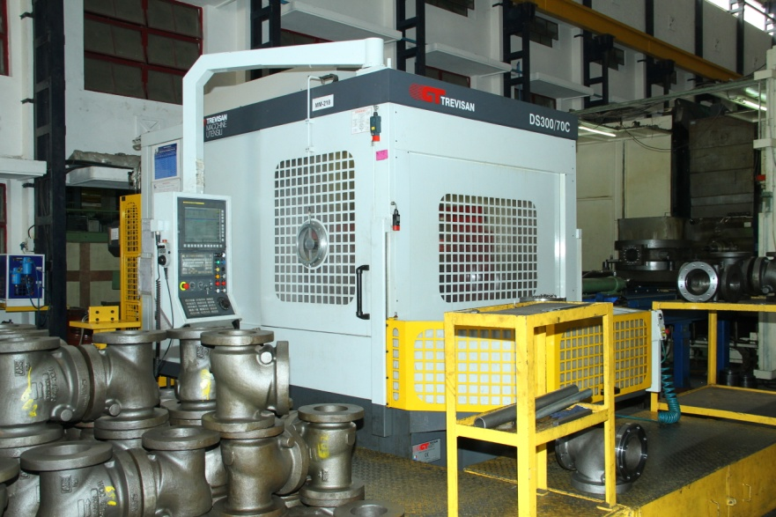
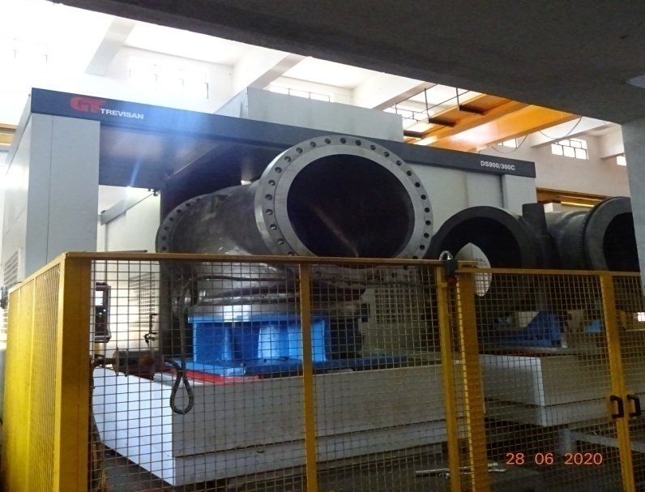
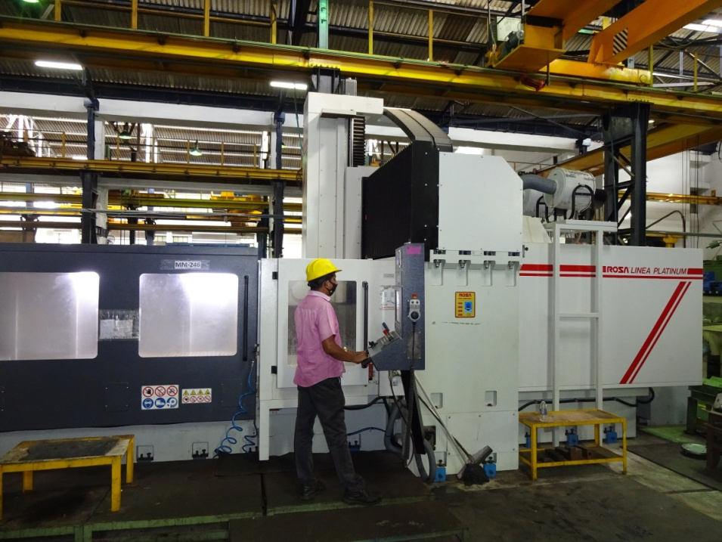
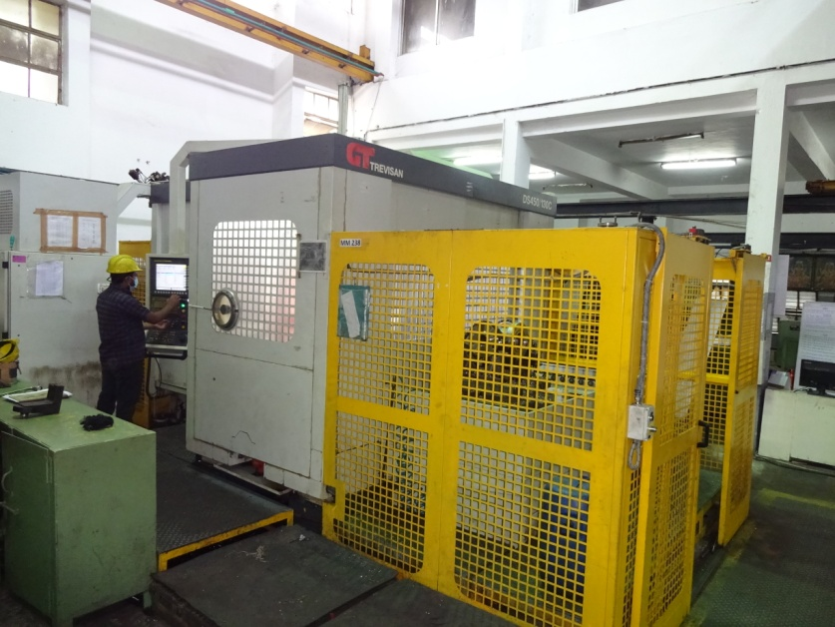
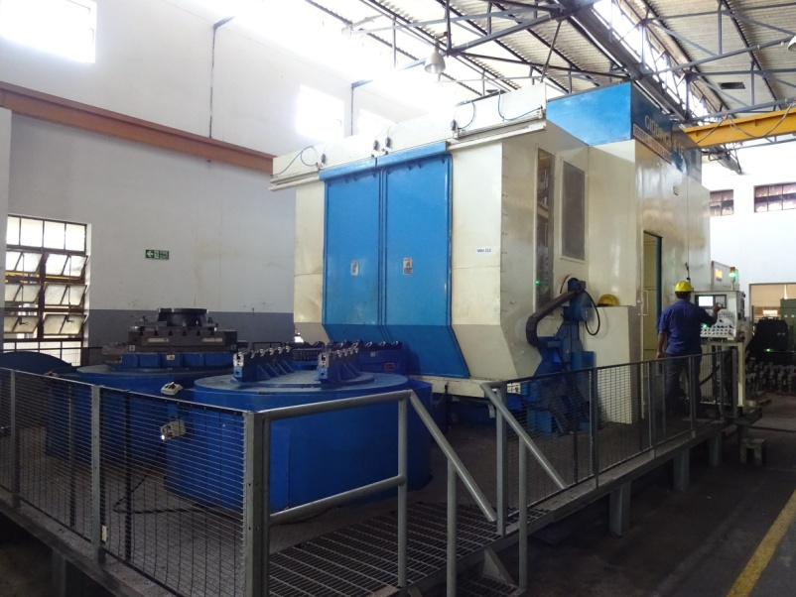
Trevisan DS300/70C
Trevisan DS900/300C
ROSA ERMANDO – PLATINUM
GRINDING MACHINE
Trevisan DS450/130C
GIDDING & LEWIS – ORION 2300

Slide 9
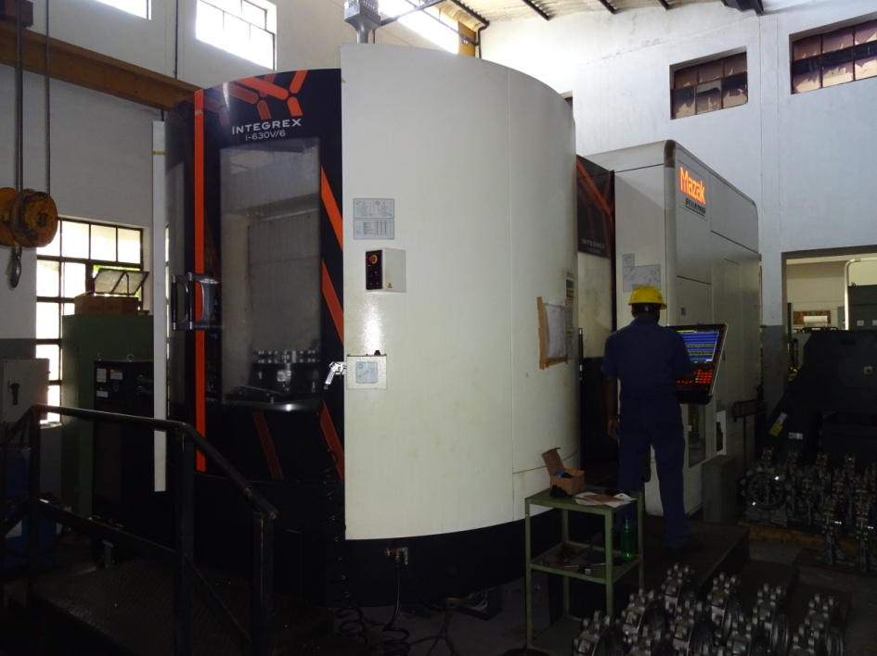
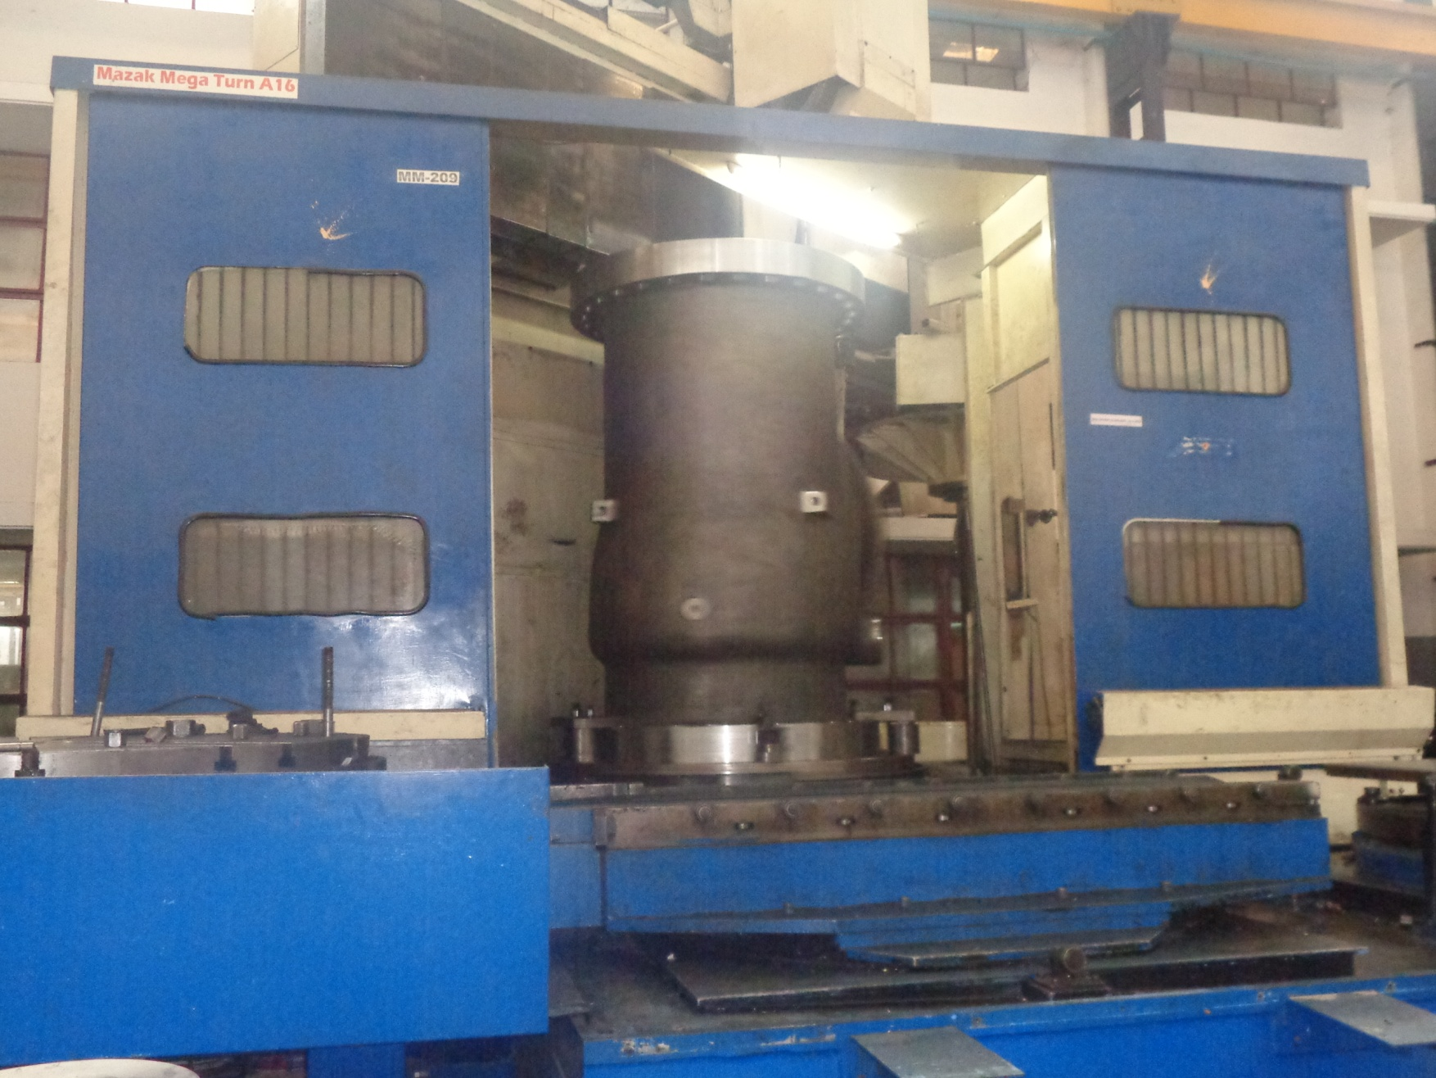
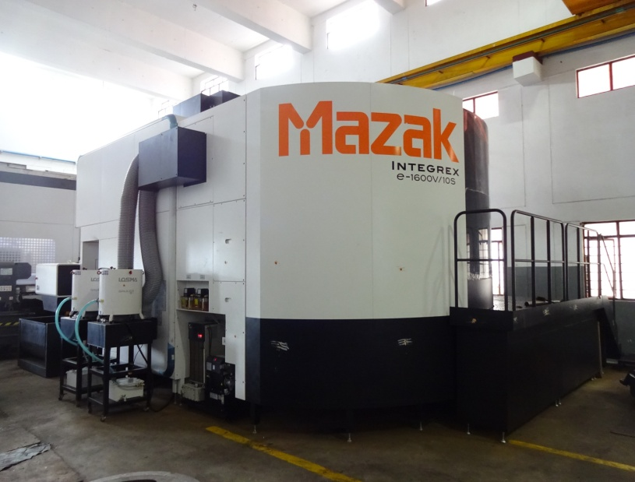
Mazak I630V
Mazak Mega Turn A16
Mazak E1600V

Slide 10
SPECIAL TESTING FACILITIES
1. Fully automated and manual Hydro Pressure Testing
2. Cryogenic Testing from -40 Deg To -196 Deg C
3. Fire safe Testing
4. Cycle Testing
5. Vacuum Pressure Testing
6. Flow Testing Laboratory
7. High Pressure Gas Testing
8. Fugitive Emissions Testing

Slide 11
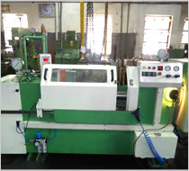
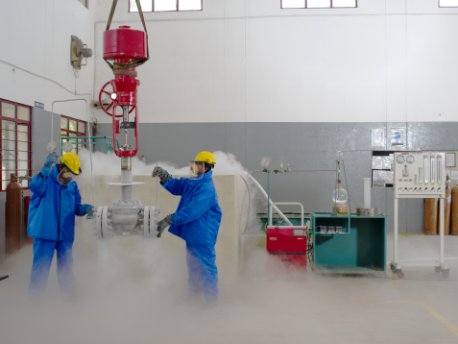
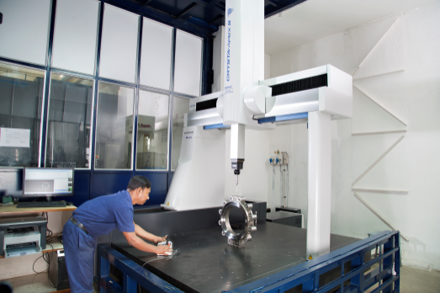
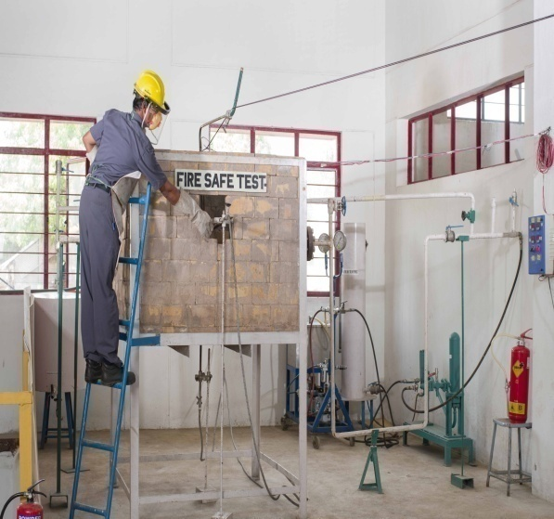
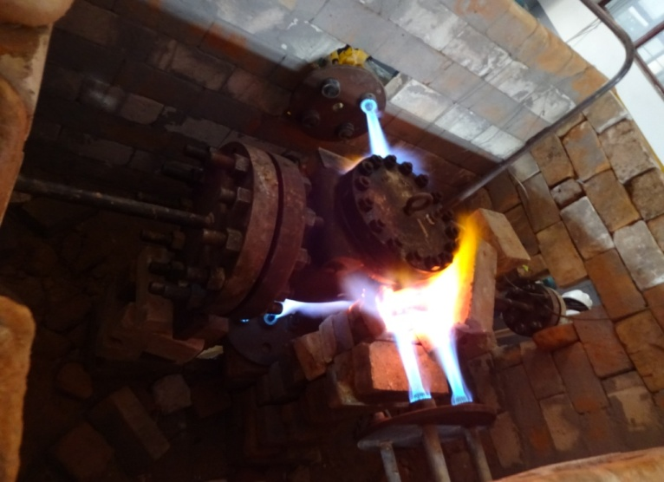
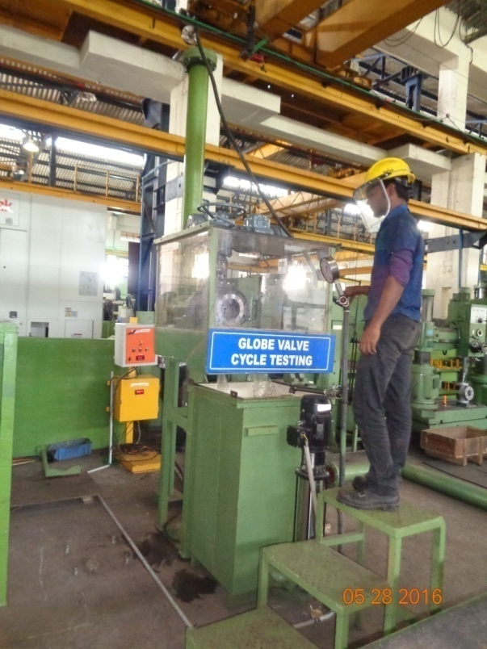
Fully automated and manual hydro testing
Cryogenic testing from -40 Deg To -196 Deg C
CMM
Fire safe testing
Cycle testing

Slide 12
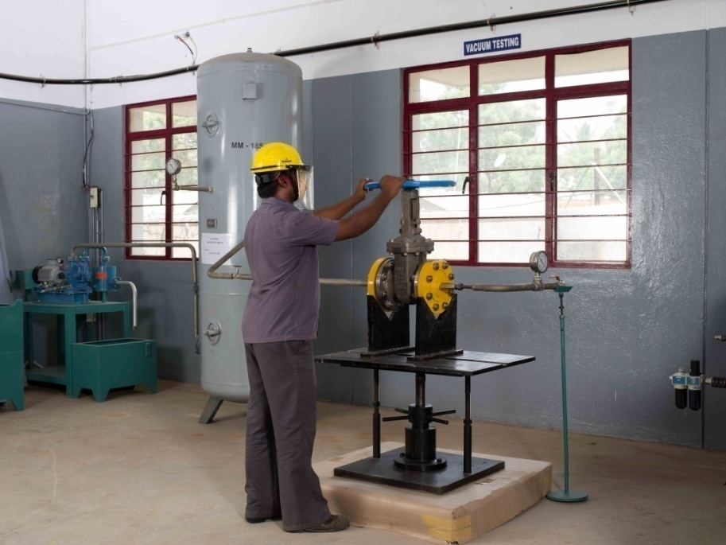
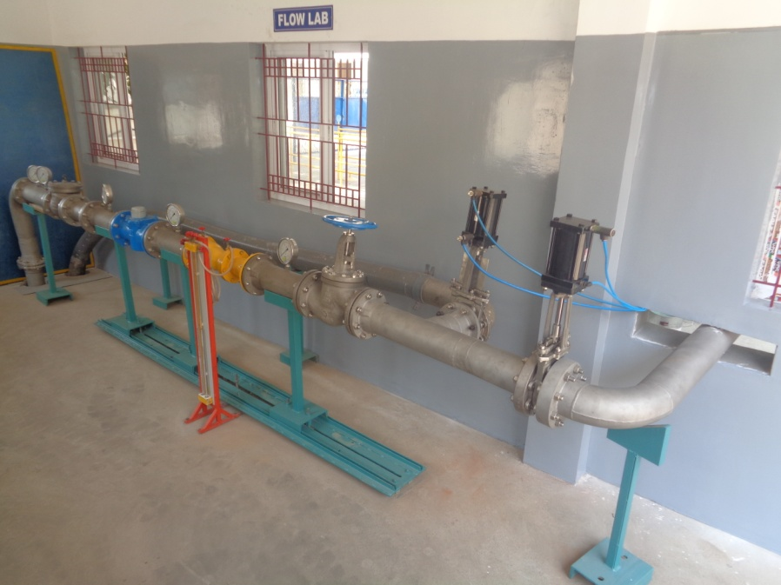
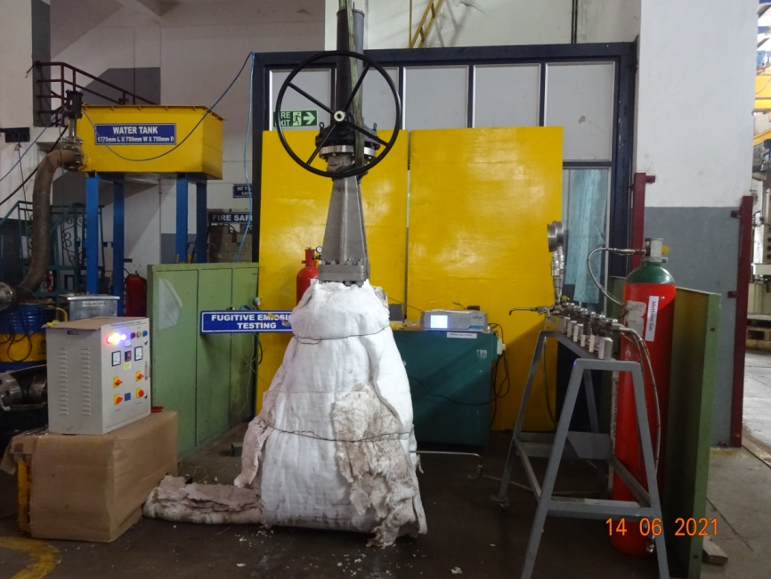
Vacuum testing
Flow Testing laboratory
Fugitive Emission Testing

Slide 13
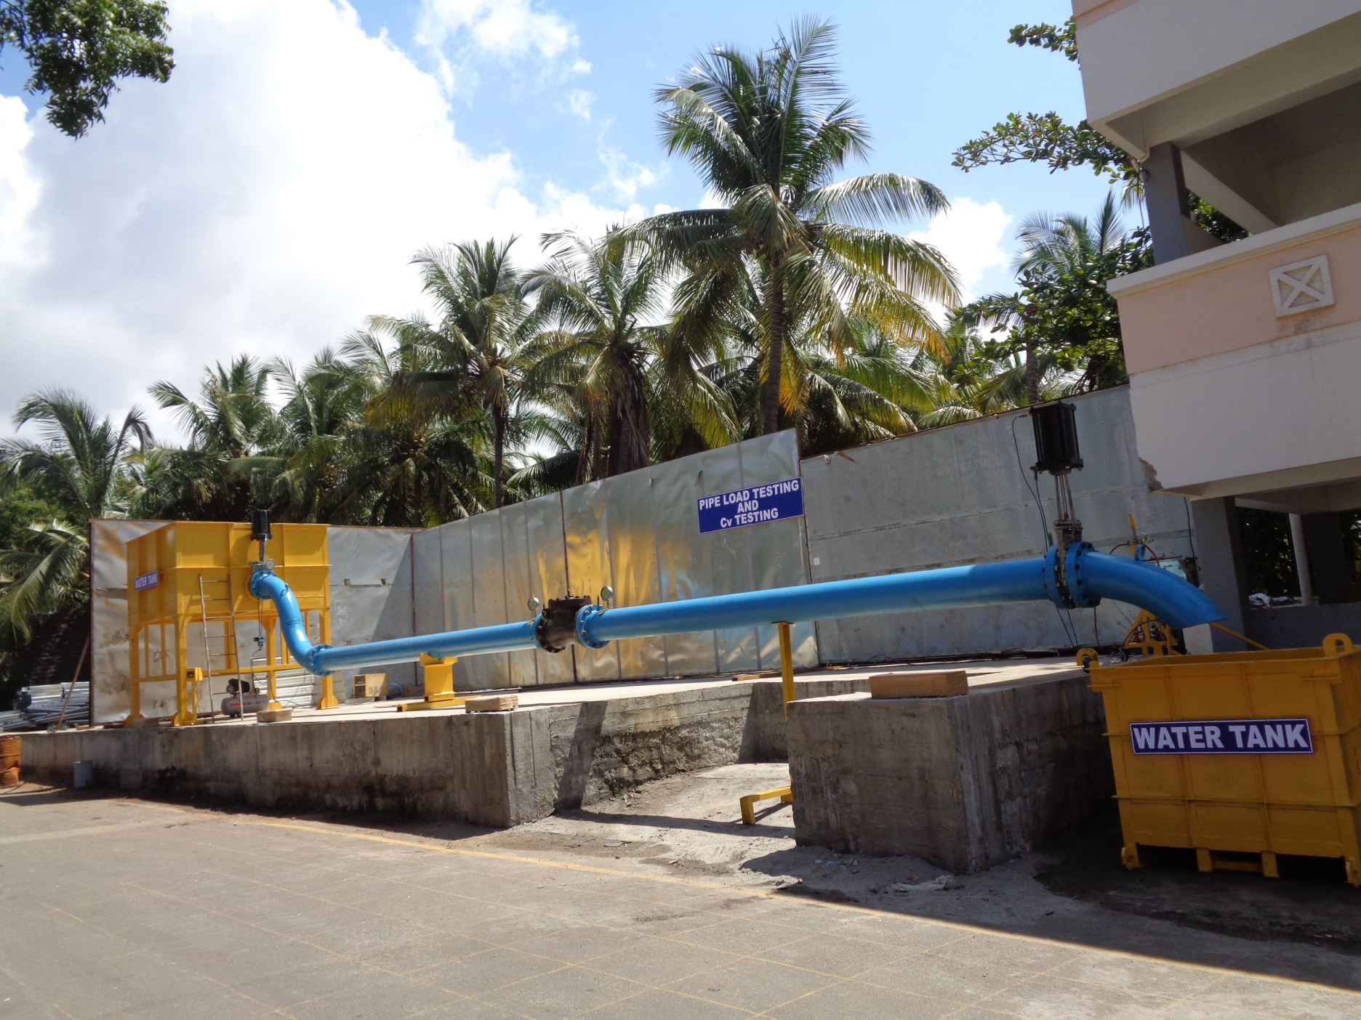
Pipe Load Testing and Cv Testing

Slide 14
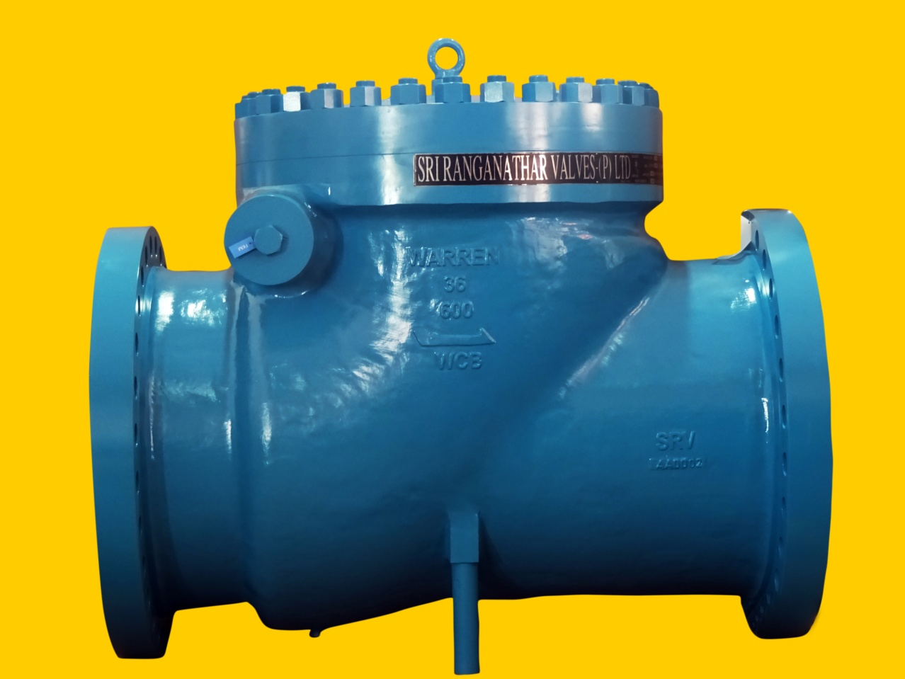
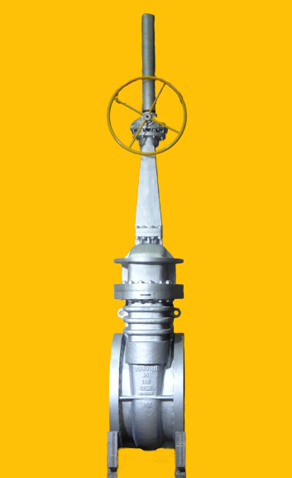
Valve Photos
Swing Check Valve – 36” #600 Wedge Gate Valve - 36” #150

Slide 15
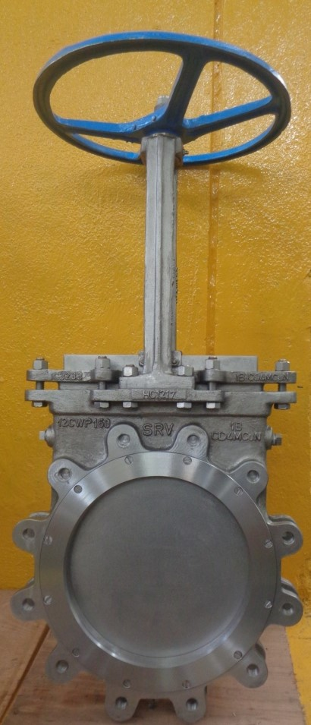
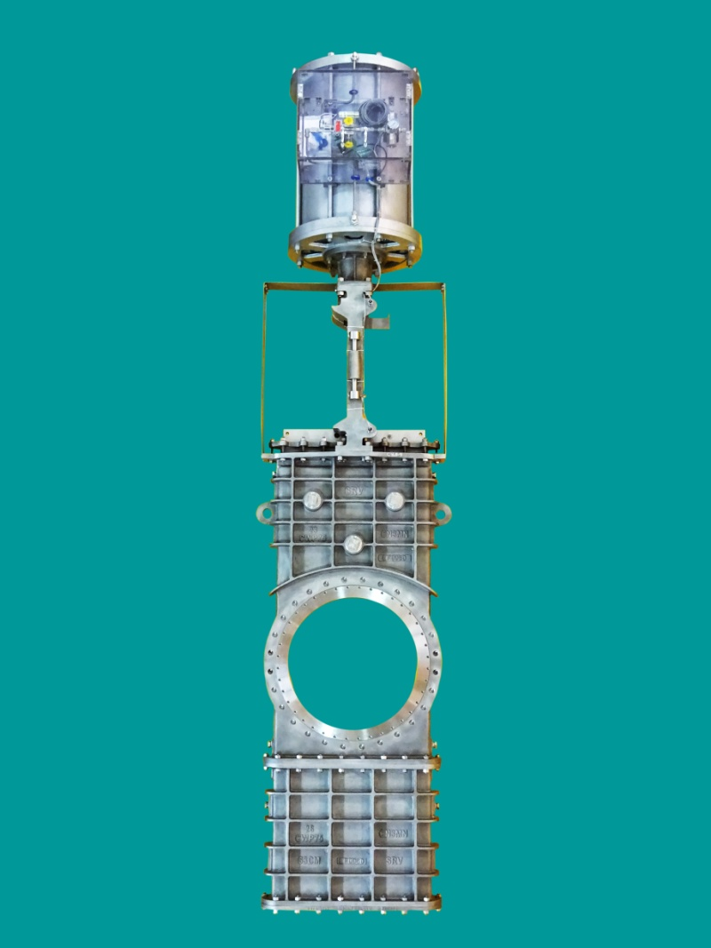
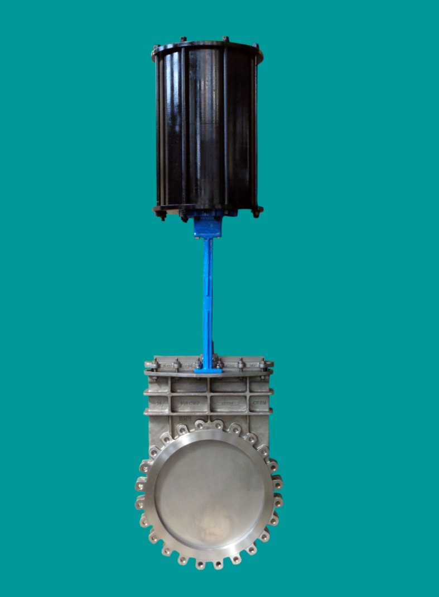
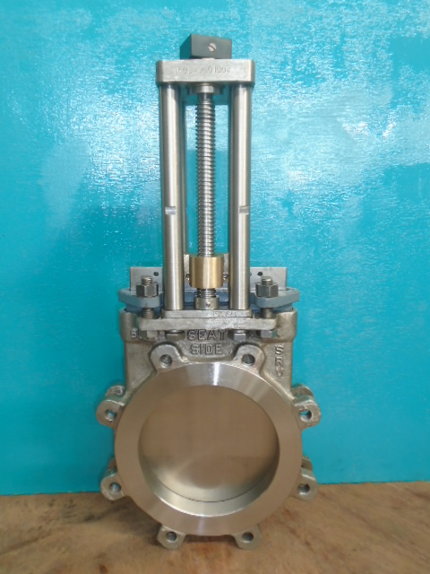
Knife Gate Valve – Model 61
Google Gate Valve – Model 63
Knife Gate Valve with Air cylinder – Model 60
Knife Gate Valve – Non Raising Stem

Slide 16
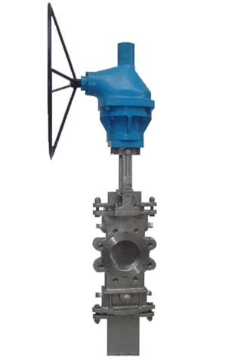
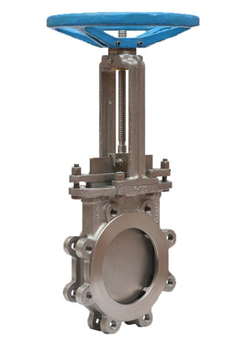
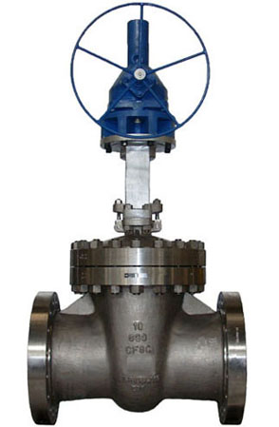
Wedge Gate Valve Knife Gate Valve Goggle Gate Valve

Slide 17
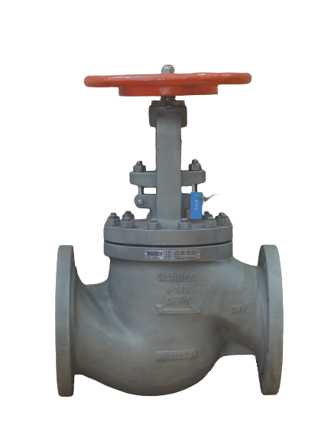
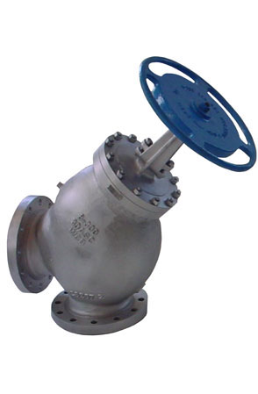
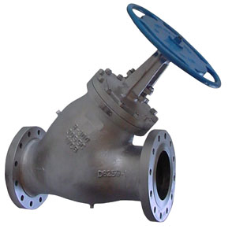
Globe Valve Angle Stop Check Valve Straight Stop Check Valve

Slide 18
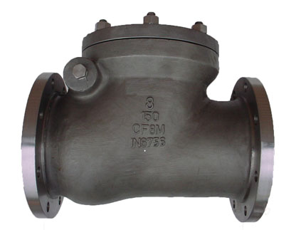
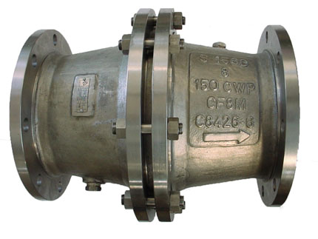
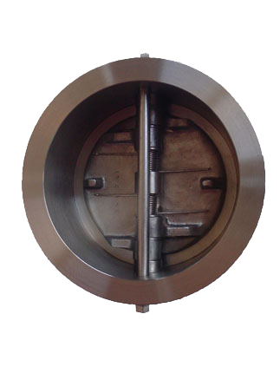
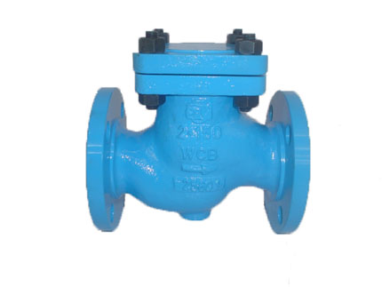
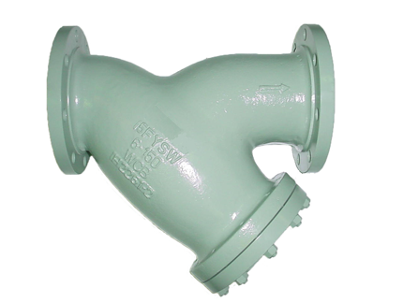
Swing Check Valve Tilting Disc Check Valve
Lift Check Valve Strainer Dual Disc Check Valve

Slide 19
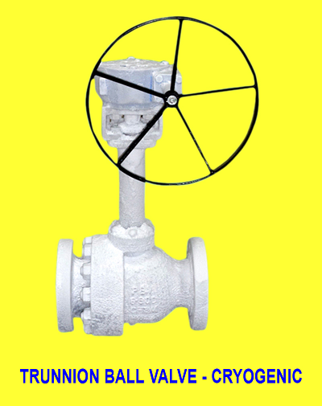
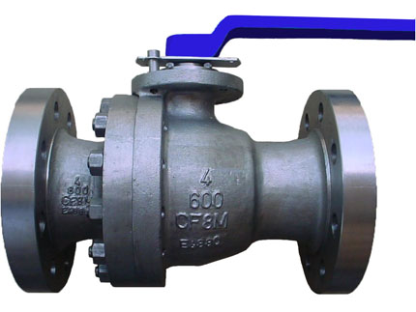
Floating Ball Valve

Slide 20
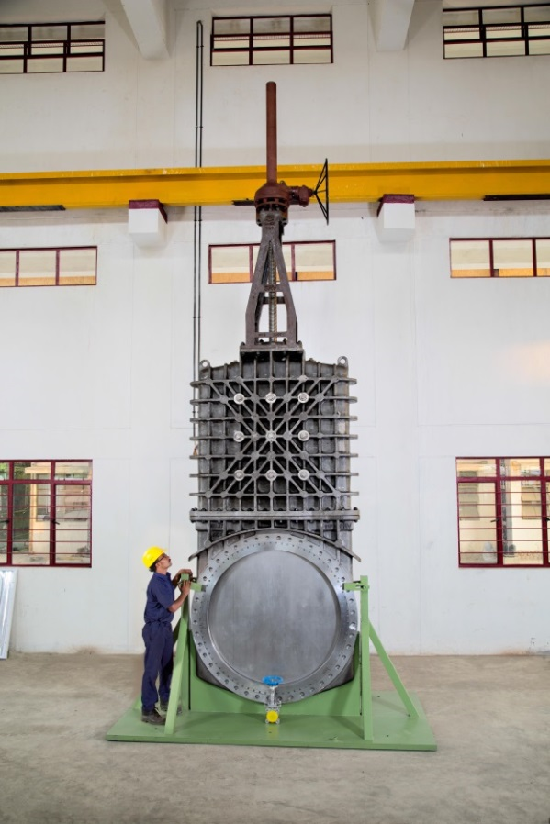
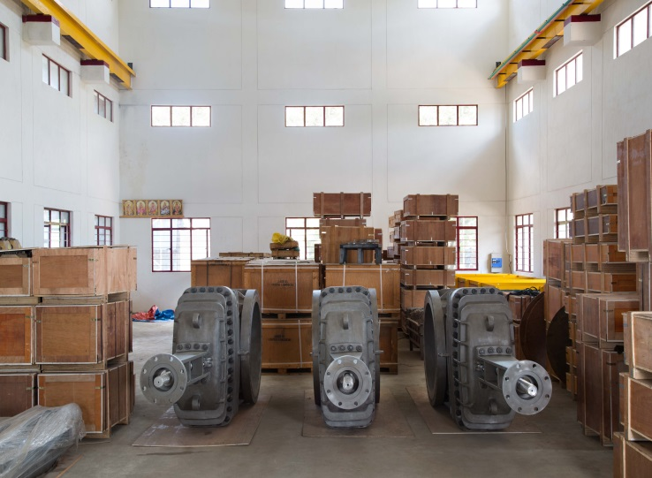
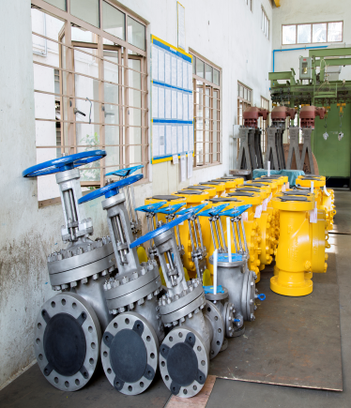
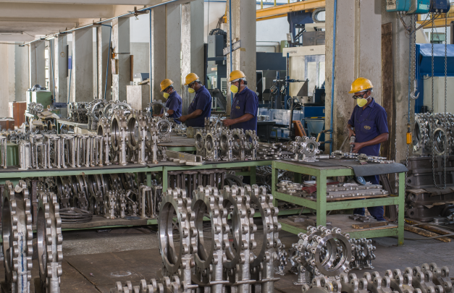
Bonneted Knife gate valve

Slide 21
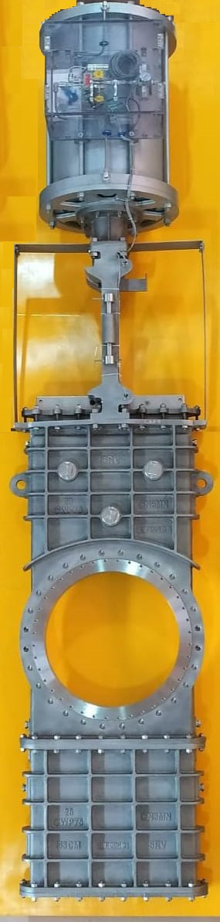
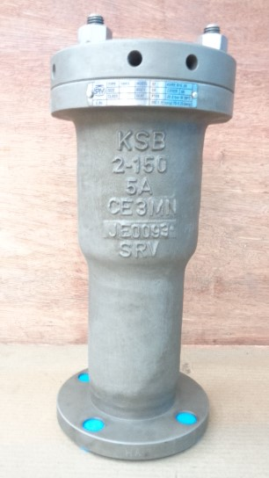
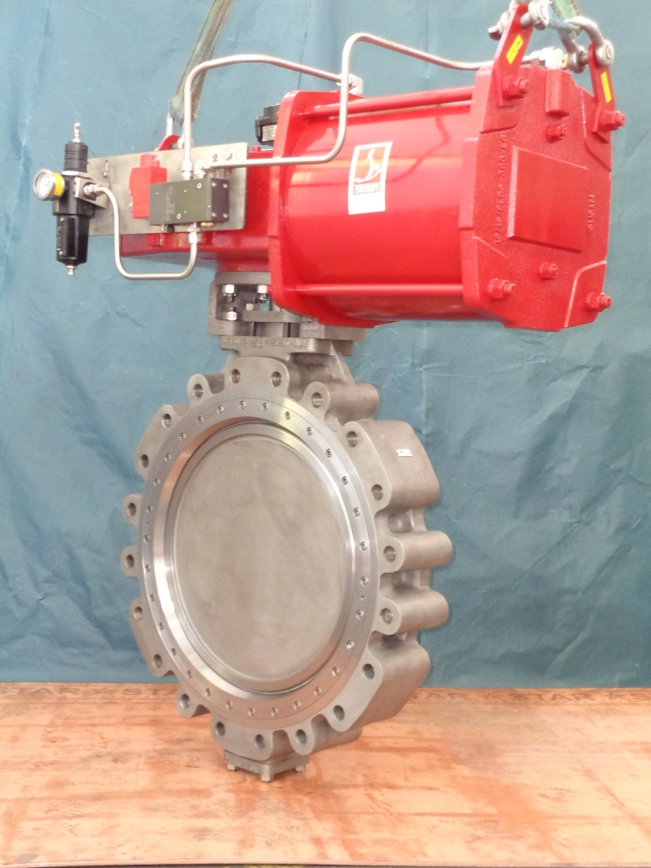
Goggle gate valve CN3MN
with Actuator
Triple offset Butterfly Valve Gr. 6A with Actuator
Air Release Valve Gr. 5A

Slide 22


40” Tilting Disc Check Valve with Hydraulic Cushion
60” Knife Gate Valve

Slide 23



Segmented Ball Valve
Vaccum Breaker Valve
Angle Globe Valve

Slide 24


Machined Casting
Pilot Relief Valve Nozzle
Gate and Segment for 36” Power-Seal Gate Valve

Slide 26

















Major Customers

Slide 27


Companies Corporate Social Responsibilities
Sri Ranganathar Institute of Engineering & Technology
Sri Ranganathar Institute of Polytechnic College

Slide 28

Thank you
Sri Ranganathar Valves (P) Ltd
7/109 – Thennampalayam Pirivu,
Arasur, Coimbatore – 641407
Tamilnadu, India.
Phone : +91 422 433 5999
Mobile : +91 99528 44102
Email: srv@sriindia.net

